Slide 1
Client Object Model

Slide 2
Outline
Overview of the Client Object Model
.NET Client Object Model
Silverlight Client Object Model
ECMAScript Client Object Model

Slide 3
Overview of the Client Object Model

Slide 4
Why Client Object Model?
More SharePoint Web services is a major request
Client Object Model provides complete API instead of more services
Provides an abstraction layer to return results as recognizable SharePoint objects
Consistent developer experience across platforms (.NET, ECMAScript, Silverlight)
Notes:
Throughout each SharePoint release, Microsoft receives more and more requests for new Web Services
Instead of continuously building new Web services (and replacing existing ASMX services with WCF services), they now provide a client object model
The client object model provides an abstraction layer so process off the SharePoint server can interact with SharePoint using a consistent API that is very closely matched to the familiar server API

Slide 5
Supported Areas
Site Collections and Sites
Lists, List Items, Views, and List Schemas
Files and Folders
Web, List, and List Item Property Bags
Web Parts
Security
Content Types
Site Templates and Site Collection Operations
Notes:
The Client Object Model contains a lot of overlap coverage with the full SharePoint API

Slide 6
Equivalent Objects
Server (Microsoft .SharePoint) | .NET Managed (Microsoft.SharePoint .Client) | Silverlight (Microsoft.SharePoint .Client.Silverlight) | ECMAScript (SP.js)
SPContext | ClientContext | ClientContext | ClientContext
SPSite | Site | Site | Site
SPWeb | Web | Web | Web
SPList | List | List | List
SPListItem | ListItem | ListItem | ListItem
SPField | Field | Field | Field
Member names mostly the same from server to client (e. g., SPWeb.QuickLaunchEnabled = Web.QuickLaunchEnabled)
Notes:
Similar to programming against server objects in the server context, the new client-side object models use a ClientContext object as the "center of gravity" for all operations. The process of obtaining and working with sites and data begins by retrieving a context object.
Show the various resources and their locations
Server – Microsoft.SharePoint – [..]\14\ISAPI
.NET – Microsoft.SharePoint.Client – [..]\14\ISAPI
Silverlight – Microsoft.SharePoint.Client.Silverlight – [..]\14\LAYOUTS\ClientBin
ECMAScript – SP.js - [..]\LAYOUTS

Slide 7
Using the Client Object Model
ECMAScriptControls and Logic
Browser
Client.svc
Server OM
JSON Response
ECMAScript OM
XML Request
Proxy
XML Request
Proxy
Content database
JSON Response
Managed OM
Managed Client
Managed Controls and Logic
SharePoint Server
Notes:
This diagram displays how the transport mechanism works
Manage client OM = .NET / Silverlight
All communication goes through the client.svc WCF service
Microsoft implemented the client OM by decorating the core SharePoint OM with attributes if it was “client aware”
[ClientCallableType(Name=“Web”,[…]),[…]]
public class SPWeb {}
Then a code gen tool generates the client OM assemblies and JavaScript
This ensures that there’s fidelity between all the client OM’s and the server equiv

Slide 8
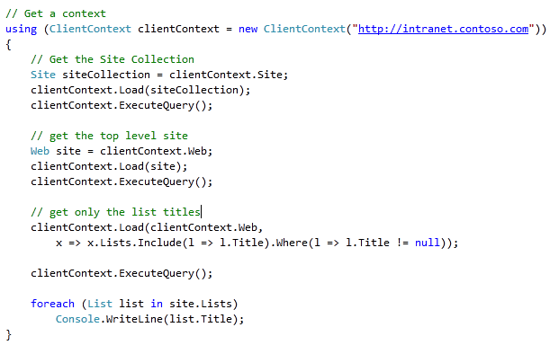
.NET Client OM
Notes:
There are two new methods: context.Load(object, params LinqExpression) & context.LoadQuery.
Load will “fill out” objects in the context in the same way that RetrieveItems/Retrieve did. Common operations:
clientContext.Load(clientContext.Web); // will retrieve all of the scalar properties for the web (e.g., .Title or .Description, but not .Lists).
clientContext.Load(clientContext.Web.Lists); // will retrieve all lists, and their scalar properties for the web.
LoadQuery lets a developer use a LINQ query to get custom objects back from SharePoint.
These objects are not “filled” into the context (e.g., if you do a query to get all lists of the context web, subsequent requests to clientcontext.Web.Lists still returns 0); they are separate from the ClientContext and it is up to the developer to use, and manage the lifetime of, those objects as they see fit.
It’s important to know that when considering the Linq-based query syntax, there are a few concepts you should consider. Linq generally has two query syntaxes:
Linq "Pretty Query" syntax. This is the Linq everyone knows and loves and uses SQL-like, typesafe clauses.
Linq "Lambda" syntax. This is a less-friendly, but at least consistent and more powerful, way to request data using Linq. Although a lot of scenarios may start with the "Pretty Query" syntax, in many cases Lambda syntax must be used for more advanced scenarios.

Slide 9
.NET Client OM
demo

Slide 10
Silverlight Client OM
Silverlight Development Enabled by Client OM
Can use Silverlight in separate ASPX page or in Web Part
Can utilize Client OM in Silverlight to create SharePoint apps
Notes:
By default, the managed client object models authenticate users by using their Windows credentials (DefaultCredentials). Optionally, you can change the authentication mode on the ClientContext object and specify using Forms authentication instead. A user must then supply a user name and password through properties on ClientContext. Behind the scenes, Windows SharePoint Services “14” calls the Authentication Web service, obtains the correct cookie, and then makes the necessary object model calls. To run managed client code against a Forms authentication server, you must change to Forms authentication. This requirement does not apply to the JavaScript object model.
The managed client object models provide a ClientAuthenticationMode enumeration whose values are Anonymous, Default, and FormsAuthentication. To specify Forms authentication, use code similar to the following:
clientContext.AuthenticationMode = ClientAuthenticationMode.FormsAuthentication;
In addition to setting the authentication mode, you must specify the user name and password information, such as follows:
FormsAuthenticationLoginInfo formsAuthInfo = new FormsAuthenticationLoginInfo("MyUser", "MyPassword");
clientContext.FormsAuthenticationLoginInfo = formsAuthInfo;
Note: Currently, the account name and password in formsAuthInfo are sent in clear text, so you must use HTTPS protocol instead of HTTP.

Slide 11
Creating Silverlight Web Parts
A Web Part can be a host for Silverlight
SharePoint ships with Silverlight web part
The web part can contain custom properties that are sent to Silverlight via the InitParameters property
The XAP file can be deployed to LAYOUTS and loaded at run time
The Silverlight application can then make use of the Client OM.
Notes:
Here we explain the basics of creating a Silverlight web part and how to create a feature that deploys the XAP file and web part. We also explain how the XAP file is loaded at run time and how web part properties may be passed to the Silverlight application.
For Silverlight client installations, Microsoft SharePoint Foundation deploys Microsoft.SharePoint.Client.Silverlight.dll and Microsoft.SharePoint.Client.Silverlight.Runtime.dll into a special "Scripts only" folder of the /_layouts virtual directory named clientbin. This folder is designed to be a standard place for hosting assemblies that are used in Silverlight.

Slide 12
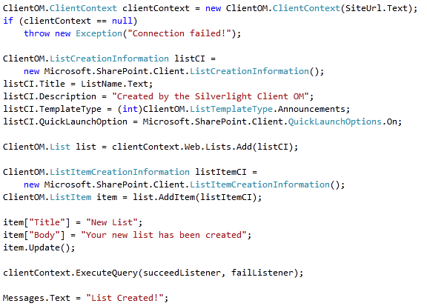
Silverlight Client OM

Slide 13
Silverlight Web Part
demo

Slide 14
ECMAScript Client OM
ECMAScript Client OM is easily added to a SharePoint ASPX page - reference:
_layouts/sp.js
Add this using <SharePoint:ScriptLink>
All libraries crunched for performance
Use un-crunched *.debug.js by adding
<SharePoint:ScriptLink … ScriptMode=“Debug” />
Method signatures can be different
Different data value types
Notes:
Compressed and crunched .js files for the ECMAScript object model, named SP.js, SP.Core.js, and SP.Runtime.js, are installed in the /_layouts directory. Microsoft SharePoint Foundation also includes uncrunched, debug versions of the .js files named SP.debug.js, SP.Core.debug.js, and SP.Runtime.debug.js. You can toggle which .js file is used in Microsoft SharePoint Foundation by setting ScriptMode="Debug" in web.config. If you add <SharePoint:ScriptLink runat=”server” Name=”sp.js” Localizable=”false” LoadAfterUI=”true” /> to the page, the Microsoft.SharePoint.WebControls.ScriptLink server control registers all dependencies.
You should be aware of the following important differences between the ECMAScript and managed client object models.
The method signature may be different, as with the ClientContext constructor
The two object models use different data value types. The ECMAScript object model does not have equivalents for all the data value types in the .NET Framework managed object model.
ECMAScript regards StringCollection as string[]. On the other hand, ECMAScript has some values that the .NET Framework does not have, such as NaN, or negative and positive infinity.
The ECMAScript object model requires that you include security validation on the page through a FormDigest control; for example, <SharePoint:FormDigest id="MyFormDigest" runat="server"/>.

Slide 15
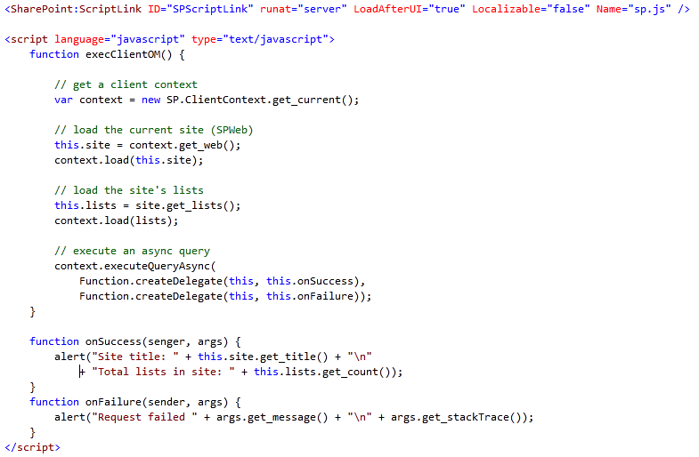
ECMAScript Client OM

Slide 16
ECMAScript Client OM
demo

Slide 17
ADO.NET Data Services
LINQ to SP not implemented in Silverlight
ListData.svc provides RESTful access
ListData.svc
Loads ADO.NET Data Services handler assembly
Microsoft.SharePoint.ListDataService.dll
Implements IDataServiceProvider interface.
Microsoft.SharePoint.Linq.dll
Implements Linq to SharePoint provider
Notes:
Can run LINQ queries against lists because the client object model does not support LINQ queries against lists.
You can use LINQ in the client OM to return object (e.g., list title is not null), but you can’t return items with the client OM (e.g., all tasks whose due date is past)
That’s why we need ADO.NET data services and that’s why we’re discussing it here

Slide 18
Summary
Overview of the Client Object Model
.NET Client Object Model
Silverlight Client Object Model
ECMAScript Client Object Model

